Slide 1

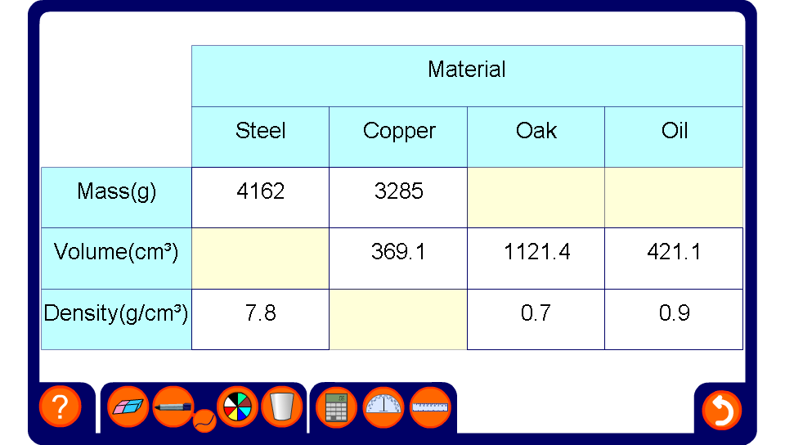


Calculating densities
Notes:
Pupils must find the missing measurements by multiplying or dividing. Establish that if density is mass divided by volume, then mass is density times volume and volume is mass divided by density.
When the table is complete ask pupils to tell you if any of the materials in the table would float on water. The density of water is 1 g/cm³.

